Slide 1

3.2.1 the influences on spending, saving and borrowing
How do the spending, saving and borrowing patterns of young workers differ from older workers?

Slide 2
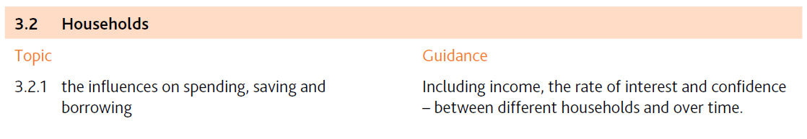

Slide 3
Spending 消费, saving 储蓄 and borrowing 借钱
Why do people save money?
How do the spending, saving and borrowing patterns of young workers differ from older workers?
  Data
  Discussion

Slide 4
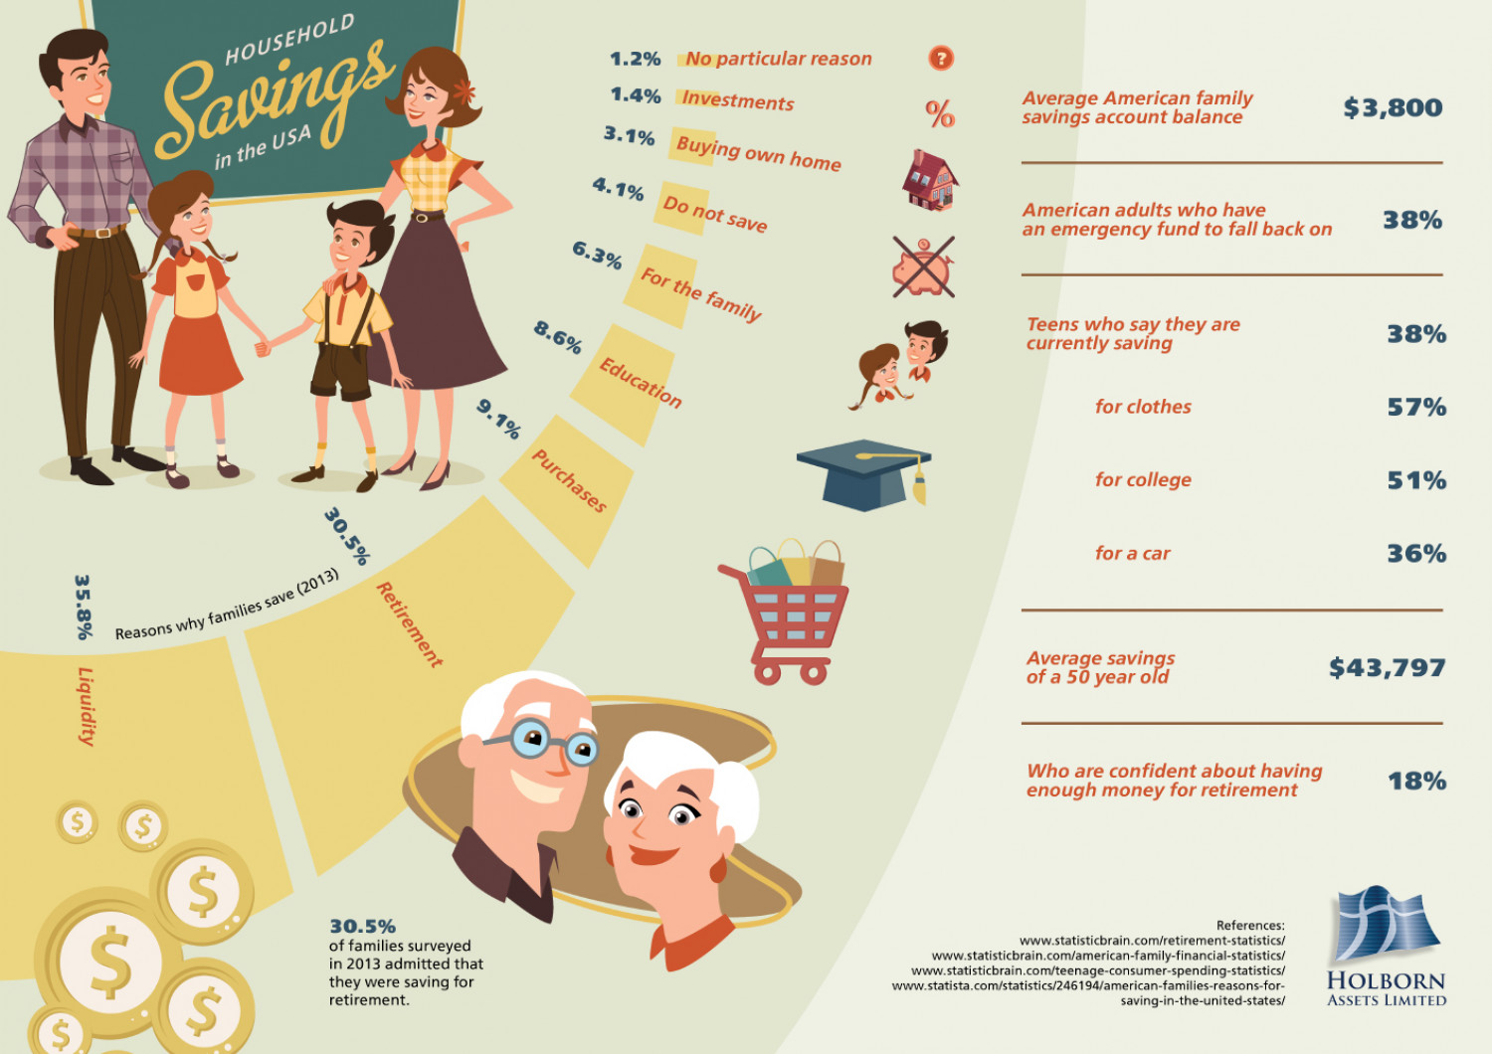

Slide 5

Explain the motives for saving.
Why do people save money?
to gain interest (return on saving)
for the future (e.g. for unexpected events, save for pensions)
to purchase expensive items
(e.g. cars, houses, furniture)
for children’s education

Slide 6
Spending 消费, saving 储蓄 and borrowing 借钱
Why do people save money?
How do the spending, saving and borrowing patterns of young workers differ from older workers?
  Data
  Discussion

Slide 7
How do the spending, saving and borrowing patterns of young workers differ from older workers?

Slide 8
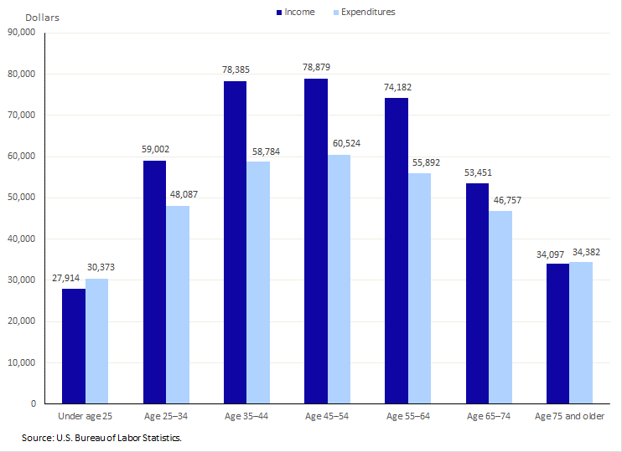
Income
Spending
At which age do people consume most?
At which age do people borrow most?
At which age do people save most?

Slide 9
Income
Spending
Why is consumption highest between ages 45 and 54?
Why is borrowing highest under age 25?
Why is saving highest between ages 35 and 44?

Slide 10
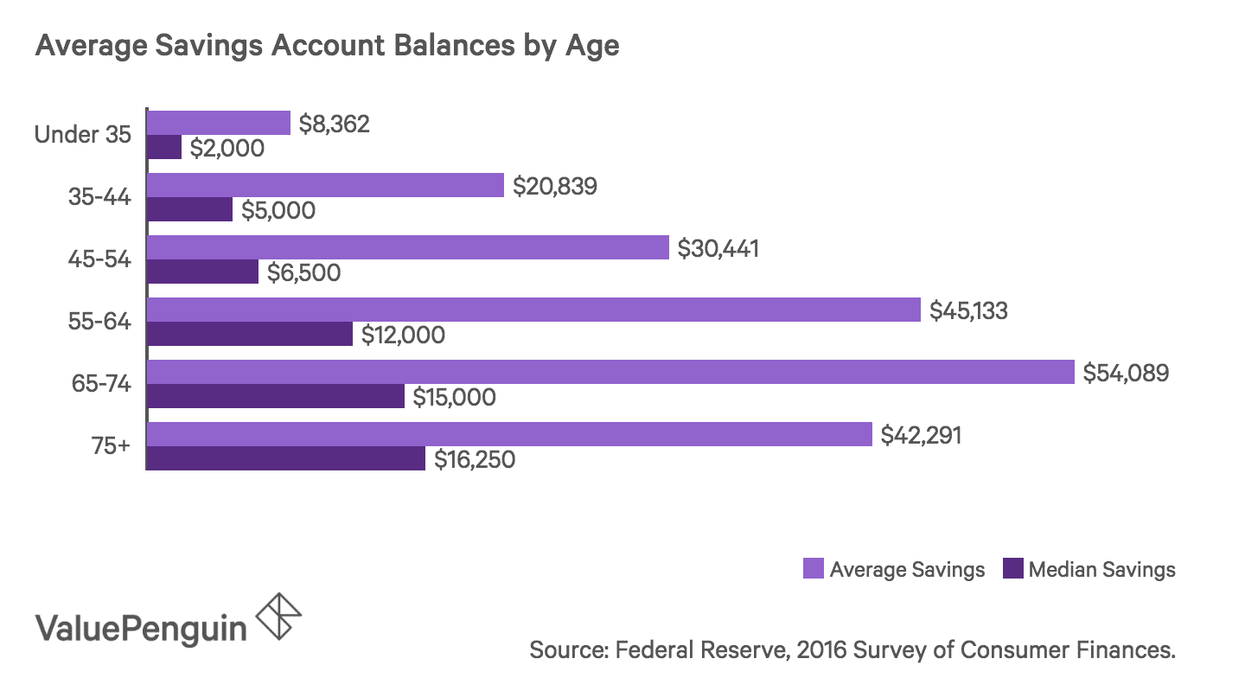

Slide 11
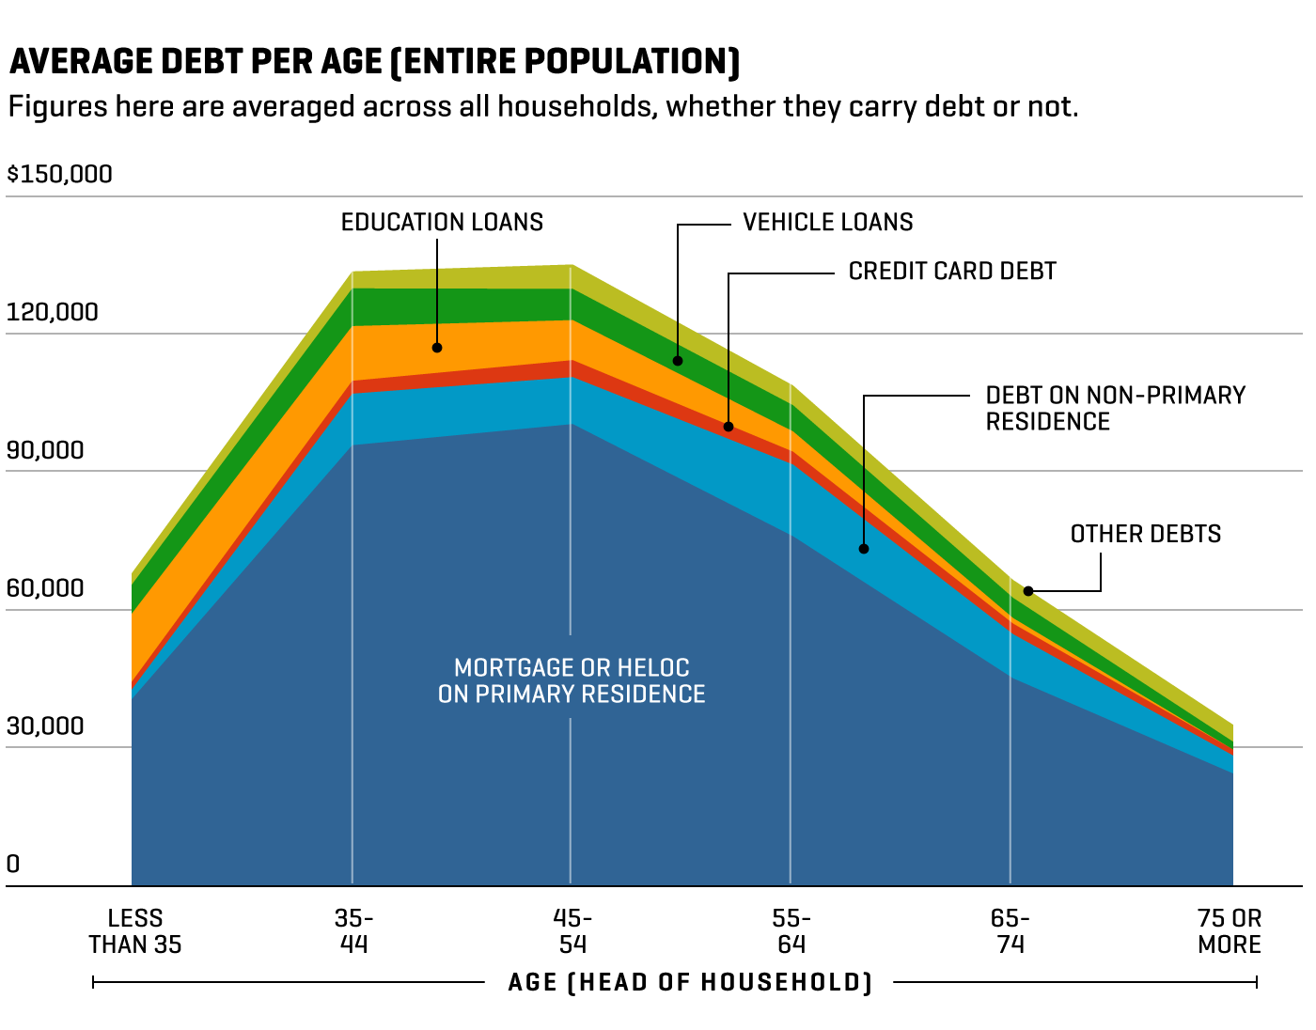
How does debt (债) change over the course of somebody’s life?

Slide 12
Spending 消费, saving 储蓄 and borrowing 借钱
Factors that affect the level of consumers expenditure
How do the spending, saving and borrowing patterns of young workers differ from older workers?
  Data
  Discussion

Slide 13
How do the spending, saving and borrowing patterns of young workers differ from older workers?
Do young workers spend more or less?
Which goods and services do young workers consume more/less than old workers?
Do young workers save more or less?
Do young workers borrow more or less?

Slide 14


How do the spending, saving and borrowing patterns of young workers differ from older workers?
1. Do young workers spend more or less than old workers?
may spend less since they are paid lower incomes
may spend a higher percentage of their incomes as they can’t afford to save (need to afford rent, groceries etc.)
may spend more as they may not have a family to save for

Slide 15


How do the spending, saving and borrowing patterns of young workers differ from older workers?
2. Do young workers save more or less?
may save more (e.g. to purchase a house)
may save less:
  may not have sufficient income
  may not save for retirement or children’s education yet

Slide 16

How do the spending, saving and borrowing patterns of young workers differ from older workers?
3. Which goods and services do young workers consume more/less than old workers?
may spend more on high tech products, entertainment
may spend less on healthcare

Slide 17
How do the spending, saving and borrowing patterns of young workers differ from older workers?
4. Do young workers borrow more or less?
may borrow more because they may be buying a car or a house and don’t have sufficient savings
may borrow less because banks may be more reluctant to lend to young workers (young workers may have less collateral (担保) and less job security)

Slide 18

In which country do people save most money? Why?

Slide 19
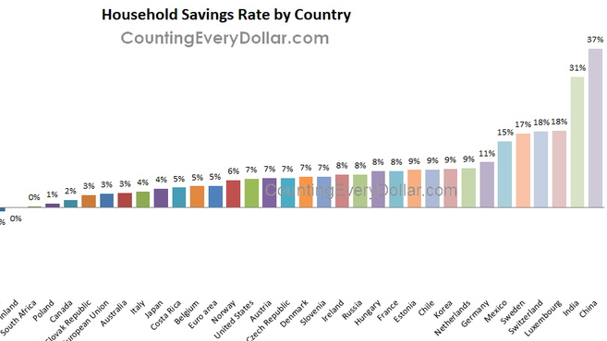

Slide 20

Why do people spend money?
Why do people save money?

Slide 21
1. Identify two motives for consumer spending. [2]
Why do people spend money?

Slide 22
1. Identify two motives for consumer spending. [2]
Why do people spend money?
to satisfy needs (e.g food, shelter)
to satisfy wants (e.g. luxury goods)
fear of future price rises
to gain satisfaction from that consumption

Slide 23




Why do households sometimes spend more and sometimes less?

Slide 24
Factors that affect the level of consumers expenditure:
real disposable income
wealth 财富
(cash, savings, stocks, houses ...)
consumer confidence
消费者信心
interest rate
实际可支配收入

